Slide 1
Message broker
Realizat de: Morari Valentin
SI-161 Postica Victor
Rotari gheorghe

Slide 2
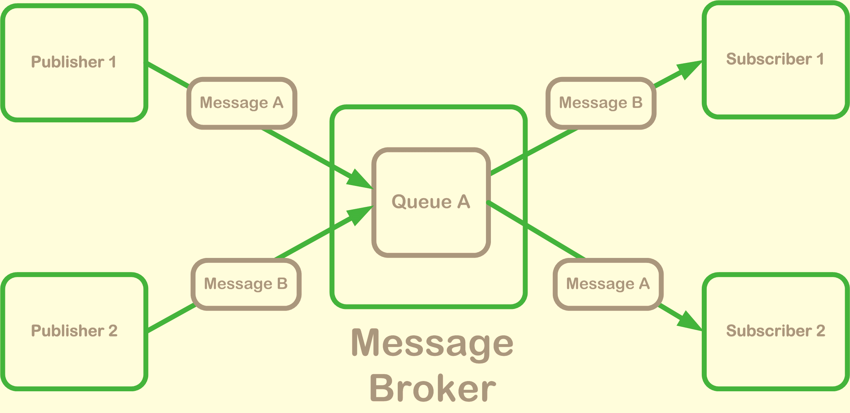
Agentul de mesaje (message broker - eng.) este o componentă fizică care gestionează comunicarea dintre componetele unei aplicații distribuite. Avantajul utilizării acestei tehnici constă în decuplarea receptorului de transmițătorul mesajelor. Prin urmare o aplicație participantă transmite mesaje doar agentului, indicînd un nume logic al receptorului.

Slide 3
Elementele implementate de către message broker
Message Channel (Messaging Systems) (+ Serializare, + Schimbarea tematicii, + Istoricul mesajelor)
Message Translator (Messaging Systems)
Publish-Subscribe Channel (Messaging Channels)
Dead Letter Channel (Messaging Channels)
Content-Based Router (Message Routing)
Content Enricher (Message Transformation)
Wire Tap (System Management)

Slide 4
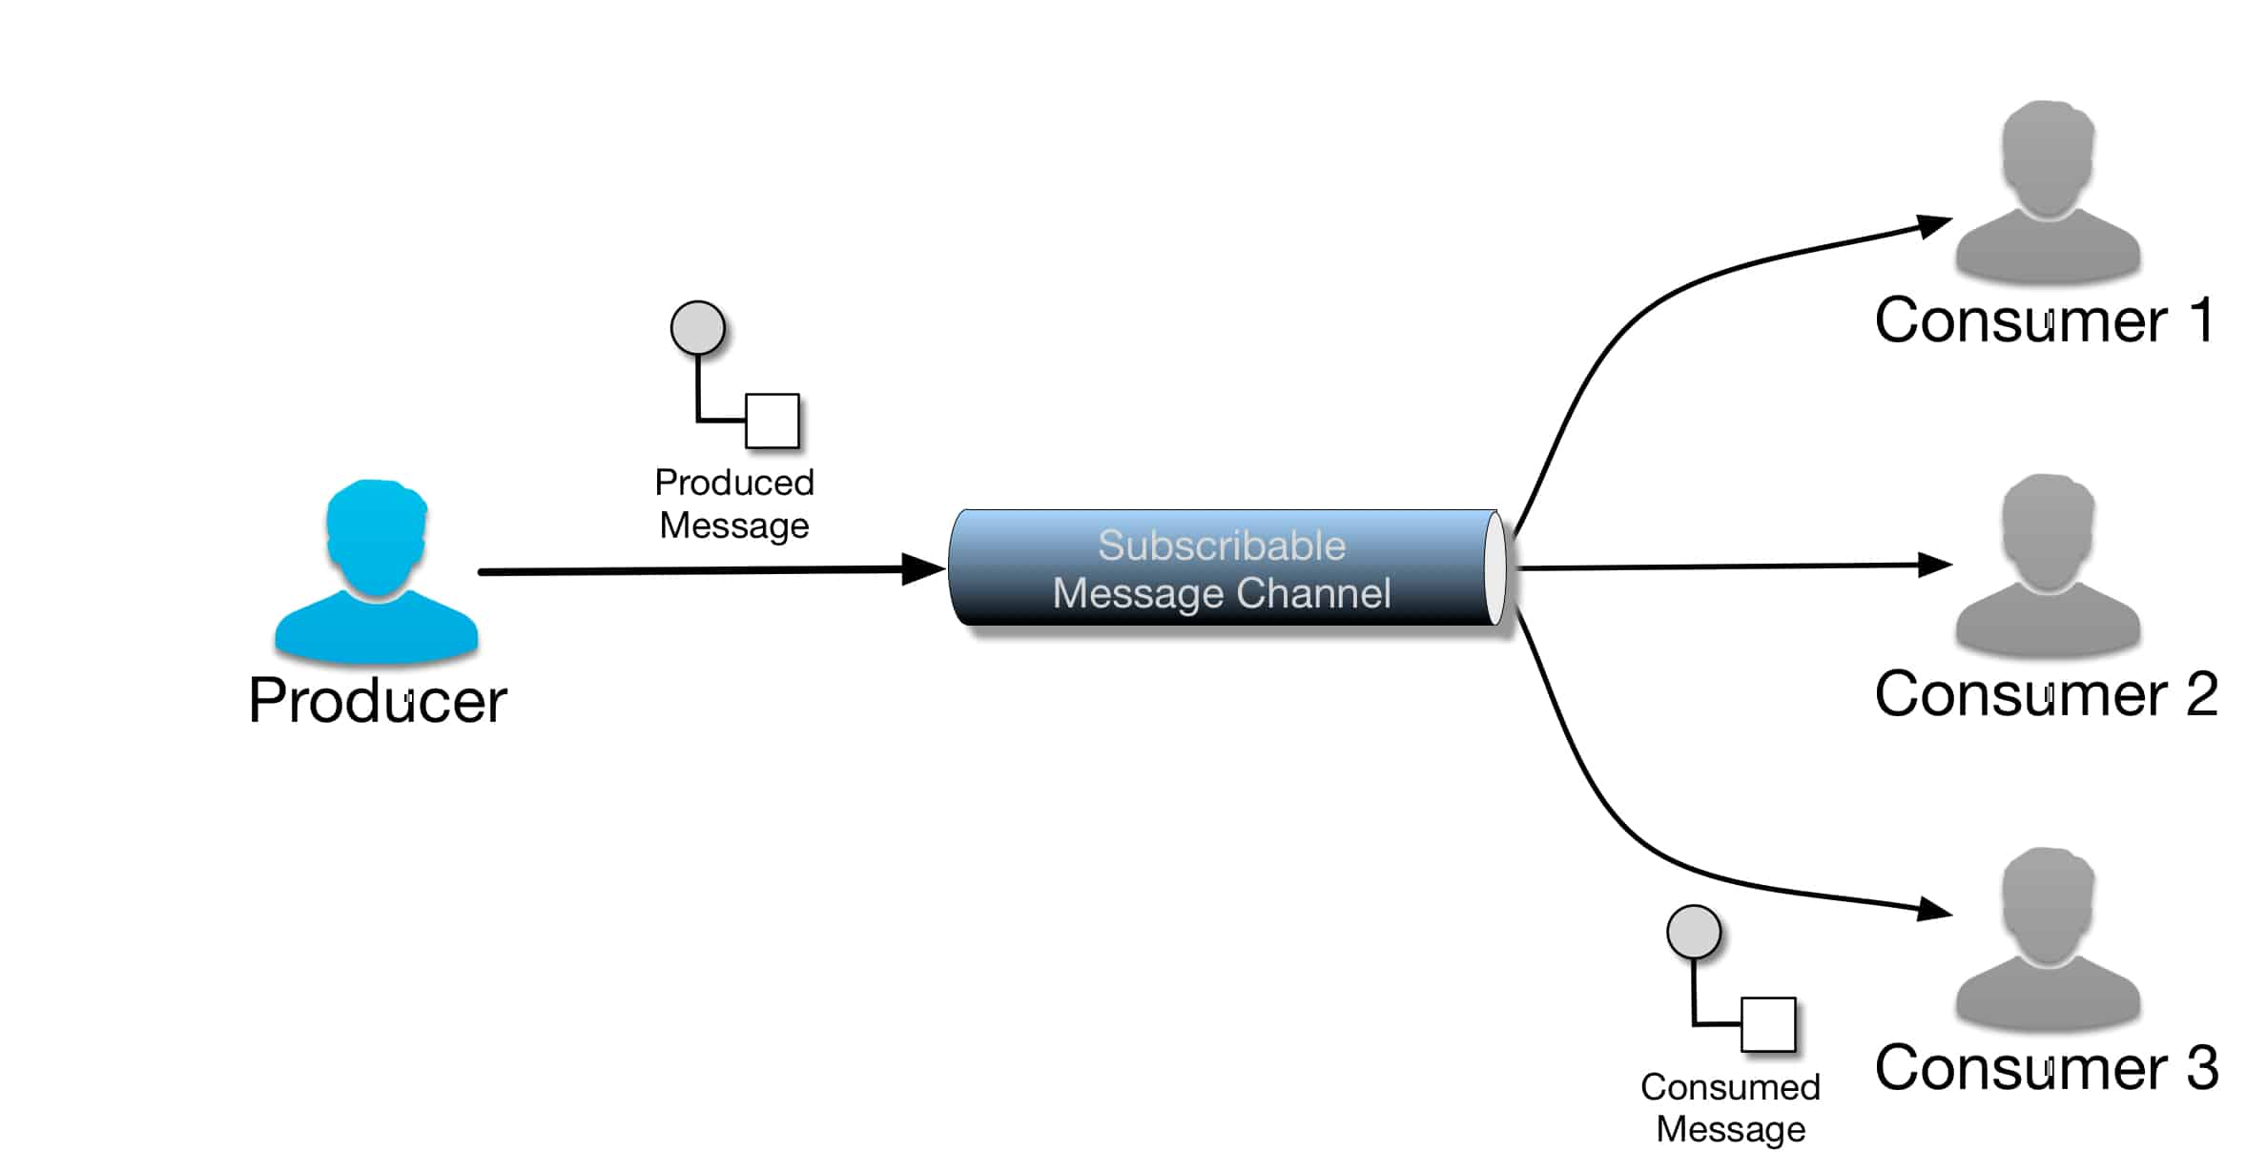
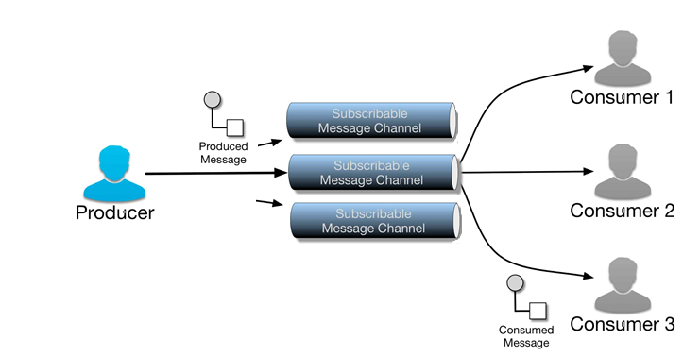
Message channel
with socket.socket(socket.AF_INET, socket.SOCK_STREAM) as s:
s.setsockopt(socket.SOL_SOCKET, socket.SO_REUSEADDR, 1)
s.bind((HOST, PORT))
s.listen(1)
SUBSCRIBERS = {"sports":[],"tv":[],"cooking":[],"errors":[]}
while True:
conn, addr = s.accept()
res = []
print ("New connection!", str(addr))
data = conn.recv(1024)

Slide 5
Message channel 1 - serializarea
Serializarea - are loc in momentul expedierii mesajului de catre client, cu marime a buffer-ului cunoscunta de 1024. Aceasta marime poate fi modificată. Separăm mesajul introdus de către utilizator în mai multe mesaje cu mărimea maximală de 1024 de biți și le expediem pe rând.
MESSAGE_TYPE += str(math.ceil(len(MESSAGE+MESSAGE_TYPE)/BUFFSIZE))
DATA = CHANNEL+MESSAGE_TYPE+MESSAGE
REAL_BUFFSIZE = BUFFSIZE-len(CHANNEL)-len(MESSAGE_TYPE)
for i in range(math.ceil(len(DATA)/BUFFSIZE)): #Serialize
DATA = CHANNEL+MESSAGE_TYPE+wrap(MESSAGE,REAL_BUFFSIZE)[i]
s.sendall(DATA.encode())
if data.decode().partition(channel)[2].startswith("publish"):
n_msg = int(data.decode().partition("publish")[2][0])
for i in range(n_msg): #first char after publish

Slide 6
Message channel 2 – schimbarea tematicii
Schimbarea tematicii are loc prin asigurarea comunicarii în ambele directii de catre receptor - care prin introducerea comenzilor subscribe si unsubscribe urmate de denumirea tematicii poate să schimbe tematicile la care este abonat.
Broker:
if data.decode().partition(channel)[2].startswith("subscribe"): SUBSCRIBERS[channel].append(connection)
elif data.decode().endswith("unsubscribe"): SUBSCRIBERS[data.decode().partition("unsubscribe")[0]].remove(connection)
elif data.decode().endswith("subscribe"): SUBSCRIBERS[data.decode().partition("subscribe")[0]].append(connection)
elif data.decode().partition(channel)[2].startswith("unsubscribe"): SUBSCRIBERS[channel].remove(connection)

Slide 7
Message channel 3 – istoricul mesajelor
Are loc prin pastrarea celor mai recente 3 mesaje trimise in fiecare canal (stocate intr-un dictionar), si expedierea lor fiecarui receiver nou, in urma stabilirii conexiunii. Se introduce o pauza minora pentru a preveni comasarea accidentala a mesajelor.
Broker:
MESSAGES = {"sports":[],"tv":[],"cooking":[],"errors":[]}
for message in MESSAGES[channel]:
time.sleep(0.1) #prevent random message-joining
try:
connection.send(message.encode())
except:
handle_error(connection, message)

Slide 8
Message translator
Broker:
for language in LANGUAGES:
for connection in LANGUAGES[language]:
if c is connection:
translator = Translator(from_lang="autodetect", to_lang=language)
temp = translator.translate(to_send)
if "PLEASE SELECT TWO DISTINCT LANGUAGES" not in temp:
to_send = temp
Datorita specificului comunicarii (tematici de discutie intre oameni, datele fiind doar de tip text): am introdus posibilitatea de a specifica o limba dorita in care sa fie traduse toate mesajele expediate catre utilizatorul canalului.
LANGUAGES = {"en":[],"ro":[],"ru":[],"de":[],"fr":[]}
if data.decode().startswith("en"): LANGUAGES["en"].append(connection) elif data.decode().startswith("ro"): LANGUAGES["ro"].append(connection) elif data.decode().startswith("ru"): LANGUAGES["ru"].append(connection) elif data.decode().startswith("de"): LANGUAGES["de"].append(connection) elif data.decode().startswith("fr"): LANGUAGES["fr"].append(connection)

Slide 9
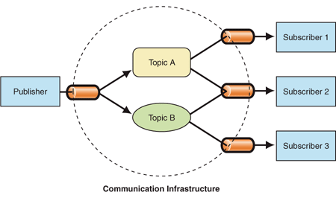
Publish-Subscribe Channel
Implementat prin oferirea unui set de canale implicite, la care receiverii se pot conecta pentru a asculta iar senderii pentru a comunica un mesaj. Toate specificatiile necesare pe parcursul utilizarii care necesita interactiunea cu utilizatorul sunt ambalate impreuna cu mesajul dorit (conform unui protocol creat) si tratate corespunzator de broker. Conexiunile noi se introduc intrun dictionar, corespunzator la tematica aleasa.
SUBSCRIBERS = {"sports":[],"tv":[],"cooking":[],"errors":[]}

Slide 10
Dead Letter Channel
Prelucrează toate mesajele trimise, dar care au esuat sa ajunga la destinatie cu succes (din diferite motive) - sunt prelucrate de un algoritm de gestiune a erorilor; in cazul in care la sfarsitul prelucrarii mesajului de catre algoritm expedierea sa nu a fost reusita, mesajul se depoziteaza intr-un canal de comunicare special-dedicat: "errors", pentru a fi putea analizat ulterior.
def handle_error(connection, message):
time.sleep(0.5) #wait half a second
try:
connection.send(message.encode())
except:
try:
time.sleep(3) #wait 3 seconds
connection.send(message.encode())
except:
MESSAGES["errors"].append(message)
for subscriber in SUBSCRIBERS["errors"]:
subscriber.send(message.encode())

Slide 11
CONTENT-BASED ROUTEr
La detectarea automata in cadrul mesajului a unor cuvinte cheie, canalul de expediere a mesajului se schimba automat corespunzator cuvintelor cheie.
for i in range(n_msg): #first char after publish
if "ball" in data.decode().partition("publish")[2][1:]:
channel = "sports"
elif "yum" in data.decode().partition("publish")[2][1:]:
channel = "cooking"
elif "watch" in data.decode().partition("publish")[2][1:]:
channel = "tv"

Slide 12
CONTENT - ENRICHER
if channel is "sports":
cursor.execute("SELECT * FROM sports")
res = cursor.fetchall()
for c in SUBSCRIBERS[channel]:
try:
to_send = data.decode().partition("publish")[2][1:]
for pair in res:
if pair[0] in to_send:
ind = to_send.index(pair[0])+len(pair[0])
to_send = to_send[:ind] + " (who plays " + pair[1] + ")" + to_send[ind:]
La selectarea unui canal, se citesc datele din baza de date si in caz ca este satisfacuta o conditie (de ex. in mesaj este numele unui jucator) - in mesajul expediat se adauga o clarificare cu datele stocate in baza de date pentru a usura intelegerea utilizatorului.

Slide 13
WIRE - TAP
La pornirea broker-ului este deschis un fisier "write-tap.txt" pentru a efectua un log a tuturor activitatilor efectuate de utilizatorii message-channelului.
f = open("write-tap.txt", "a+")
while True:
if data is not last_data: #ignore repeat-error
f.write(time.ctime() + " " + str(addr) + " " + data.decode()+"\n")

Slide 14
Anexa 1 – codul programului pentru broker
#!/usr/bin/env python3import socketimport _threadimport timeimport sqlite3connection = sqlite3.connect("mydb.db")cursor = connection.cursor()from translate import Translatorglobal connex, SUBSCRIBERS, MESSAGES, f, LANGUAGESconnex = []HOST = '127.0.0.1' # Standard loopback interface address (localhost)PORT = 65443 # Port to listen on (non-privileged ports are > 1023)f = open("write-tap.txt", "a+")SUBSCRIBERS = {"sports":[],"tv":[],"cooking":[],"errors":[]}MESSAGES = {"sports":[],"tv":[],"cooking":[],"errors":[]}LANGUAGES = {"en":[],"ro":[],"ru":[],"de":[],"fr":[]}def handle_error(connection, message): time.sleep(0.5) #wait half a second try: connection.send(message.encode()) except: try: time.sleep(3) #wait 3 seconds connection.send(message.encode()) except: #ok -- give up MESSAGES["errors"].append(message) for subscriber in SUBSCRIBERS["errors"]: subscriber.send(message.encode()) def handle_client(connection, data, channel): global connex, LANGUAGES connex.append(connection) print (SUBSCRIBERS) for message in MESSAGES[channel]: time.sleep(0.1) #prevent random message-joining try: connection.send(message.encode()) except: handle_error(connection, message) last_data = None while True: if data is not last_data: #ignore repeat-error f.write(time.ctime() + " " + str(addr) + " " + data.decode()+"\n") if data.decode().partition(channel)[2].startswith("subscribe"): SUBSCRIBERS[channel].append(connection) elif data.decode().endswith("unsubscribe"): SUBSCRIBERS[data.decode().partition("unsubscribe")[0]].remove(connection) elif data.decode().endswith("subscribe"): SUBSCRIBERS[data.decode().partition("subscribe")[0]].append(connection) elif data.decode().partition(channel)[2].startswith("unsubscribe"): SUBSCRIBERS[channel].remove(connection) if data.decode().startswith("en"): LANGUAGES["en"].append(connection) elif data.decode().startswith("ro"): LANGUAGES["ro"].append(connection) elif data.decode().startswith("ru"): LANGUAGES["ru"].append(connection) elif data.decode().startswith("de"): LANGUAGES["de"].append(connection) elif data.decode().startswith("fr"): LANGUAGES["fr"].append(connection) data = connection.recv(1024) if data is None: break last_data = data connection.close()with socket.socket(socket.AF_INET, socket.SOCK_STREAM) as s: s.setsockopt(socket.SOL_SOCKET, socket.SO_REUSEADDR, 1) s.bind((HOST, PORT)) s.listen(1) while True: conn, addr = s.accept() res = [] print ("New connection!", str(addr)) data = conn.recv(1024) f.write(time.ctime() + " " + str(addr) + " " + data.decode() + "\n") for channel in SUBSCRIBERS.keys(): if data.decode().startswith(channel): if data.decode().partition(channel)[2].startswith("subscribe"): _thread.start_new_thread(handle_client ,(conn, data, channel, )) if data.decode().partition(channel)[2].startswith("unsubscribe"): SUBSCRIBERS[channel].remove(conn) #futureproofing :P pass if data.decode().partition(channel)[2].startswith("publish"): n_msg = int(data.decode().partition("publish")[2][0]) for i in range(n_msg): #first char after publish if "ball" in data.decode().partition("publish")[2][1:]: channel = "sports" elif "yum" in data.decode().partition("publish")[2][1:]: channel = "cooking" elif "watch" in data.decode().partition("publish")[2][1:]: channel = "tv" if channel is "sports": cursor.execute("SELECT * FROM sports") res = cursor.fetchall() for c in SUBSCRIBERS[channel]: try: to_send = data.decode().partition("publish")[2][1:] for pair in res: if pair[0] in to_send: ind = to_send.index(pair[0])+len(pair[0]) to_send = to_send[:ind] + " (who plays " + pair[1] + ")" + to_send[ind:] MESSAGES[channel].append(to_send) MESSAGES[channel] = MESSAGES[channel][-3:] #maxlen = 3 print (f.read()) for language in LANGUAGES: for connection in LANGUAGES[language]: if c is connection: translator = Translator(from_lang="autodetect", to_lang=language) temp = translator.translate(to_send) if "PLEASE SELECT TWO DISTINCT LANGUAGES" not in temp: to_send = temp c.send(to_send.encode()) #ignore the number print (to_send) except Exception as e: print (e) handle_error(connection, to_send) data = conn.recv(1024) s.close()

Slide 15
Anexa 2 – codul programului pentru sender
#!/usr/bin/env python3import socketimport mathfrom textwrap import wrapHOST = '127.0.0.1' # The BROKER's hostname or IP addressPORT = 65443 # The port used by the BROKERBUFFSIZE=1024with socket.socket(socket.AF_INET, socket.SOCK_STREAM) as s: s.setsockopt(socket.SOL_SOCKET, socket.SO_REUSEADDR, 1) s.connect((HOST, PORT)) MESSAGE_TYPE = "publish" CHANNEL = input("Please introduce your channel: ") MESSAGE = input("Please introduce your message: ") MESSAGE_TYPE += str(math.ceil(len(MESSAGE+MESSAGE_TYPE)/BUFFSIZE)) DATA = CHANNEL+MESSAGE_TYPE+MESSAGE REAL_BUFFSIZE = BUFFSIZE-len(CHANNEL)-len(MESSAGE_TYPE) #s.sendall(DATA.encode()) #declare nr of stuffs for i in range(math.ceil(len(DATA)/BUFFSIZE)): #Serialize #s.sendall(DATA.encode()) DATA = CHANNEL+MESSAGE_TYPE+wrap(MESSAGE,REAL_BUFFSIZE)[i] s.sendall(DATA.encode()) #data = conn.recv(1024) print('Sent.')

Slide 16
Anexa 3 – codul programului pentru receiver
#!/usr/bin/env python3import socketimport _threadMESSAGE_TYPE = "subscribe" CHANNEL = "sports"DATA = CHANNEL+MESSAGE_TYPEBHOST = '127.0.0.1' # The BROKER's hostname or IP addressBPORT = 65443 # The port used by the BROKERs = socket.socket(socket.AF_INET, socket.SOCK_STREAM)s.setsockopt(socket.SOL_SOCKET, socket.SO_REUSEADDR, 1)s.connect((BHOST, BPORT))data = s.sendall(DATA.encode())def listen(connection, data): while True: data = connection.recv(1024) if data is None: break print('\nClient says: ' + data.decode()) connection.close() _thread.start_new_thread(listen ,(s, data, ))while True: menu = input("Command (subscribe/unsubscribe channel_name or first 2 initials for desired language): ") if menu.startswith("subscribe"): if menu.partition("subscribe ")[2]: CHANNEL = menu.partition("subscribe ")[2] MESSAGE_TYPE = "subscribe" DATA = CHANNEL + MESSAGE_TYPE data = s.sendall(DATA.encode()) elif menu.startswith("unsubscribe"): CHANNEL = menu.partition("unsubscribe ")[2] MESSAGE_TYPE = "unsubscribe" DATA = CHANNEL + MESSAGE_TYPE data = s.sendall(DATA.encode()) elif menu.startswith("en"): data = s.sendall("en".encode()) elif menu.startswith("ro"): data = s.sendall("ro".encode()) elif menu.startswith("ru"): data = s.sendall("ru".encode()) elif menu.startswith("de"): data = s.sendall("de".encode()) elif menu.startswith("fr"): data = s.sendall("fr".encode()) s.close()

Slide 17

Mulțumim pentru atenție!

